Slide 1
Welcome to this COMET presentation
We will start in just a few minutes. Please take this time to get yourself a cup of coffee/tea/water, and we will start promptly at 9 am.

Slide 2
As we gather here today, we acknowledge we are on Treaty 6, 7 and 8 Territory and the Homeland of the Métis. We pay our respect to the First Nations and Métis ancestors and reaffirm our relationship with one another.

Slide 3
YOUR JOINT PAIN
IS PERSONAL so is your treatment
Presented by the Sport and Exercise Medicine Physicians from the Sather Reid Sport Medicine Clinic and the McEwan University Health Center

Slide 4

A few housekeeping points before we get started:
please MUTE your microphone – you may unmute to ask a question
you may have your VIDEO on/off at your discretion
you may ask a question at any time in this presentation but we will pause to address questions and there will be time at the end for questions
you may type your questions in the CHAT BOX
if you are signing into this presentation using someone else’s zoom account/computer please let us know who you are
- send your name to COMET project Zoom in the chat box
we are not recording/transcribing this presentation but the slides are on the U of A family medicine website for you to review at any time
Notes:
Introduce the doctor who is moderating the questions and advise the attendees how they can ‘chat’ directly with the moderator vs the whole group in the chat box.
ASK ANYONE SIGNING IN WITH SOMEONE ELSE’S ZOOM OR A NON-IDENTIFYING USER NAME TO SEND HIS/HER NAME IN THE CHAT BOX SO WE CAN KEEP ATTENDANCE AND BE SURE THAT LETTERS ARE SENT BACK TO THE FMD REGARDING THE PATIENT’S PARTICIPATION TODAY

Slide 5
OSTEOARTHRITIS AFFECTS ALL AGE GROUPS
56% of Canadians with OA are less than 65 years of age
In 2017, 4.6 million Canadians had arthritis and we spent $33 billion dollars in health care costs treating arthritis
By 2037, 7.5 million people in Canada will have arthritis and it is expected to cost $67 billion to care for those people!
Arthritis Alliance of Canada, The Impact of Arthritis in Canada: Today and Over the Next 30 Years (Fall 2011), 32, 40; http://arthritis.ca/understand-arthritis/arthritis-facts-figures. Accessed February 27, 2017.
Notes:
Before the pandemic, we spent $33 billion dollars treating OA, and in the next 20 years, that number is expected to balloon to $67 billion dollars per year treating arthritis.
To put this into perspective: we spend more health care cost treating arthritis than Diabetes, Heart Failure and kidney failure COMBINED! The only chronic disease we spend more money treating is chronic lung disease.

Slide 6
OSTEOARTHRITIS:
3RD most common self-reported chronic condition in Canada
main cause of pain in patients 50+
most common in the knee > hip
females > males; increases with increasing age
2019: 1/6 suffer from OA…
Estimated that by 2035 1/4 Canadians will suffer with OA
Notes:
Arthritis is a very common problem, one with very limited ability to prevent the disease. There is no cure for arthritis and all our treatments are aimed at trying to reduce the progression of the disease and help the symptoms to improve quality of life of the person with arthritis.
It is the third most common self-reported chronic condition in Canada and the main cause of pain in patients +50.
It is most common in the knee, and more common in woman than men, and it does get worse as we all age.
Before the COVID pandemic, 1 in 6 persons in Canada has osteoarthritis. By 2035 it is estimated that 1 in 4 Canadians will suffer with OA!
People with OA are more than 2x as likely to say their general health and mental health is not good compared to the general population.
70% of people with OA report having at least 1 other chronic condition compared to only 40% in the general population.

Slide 7

ACTIVITIES AFFECTED BY ARTHRITIS & JOINT PAIN
Physical exercise 73%
Cleaning the house 52%
Gardening 52%
Daily chores 47%
Working 42%
Hobbies 32%
Socializing 18%
Driving 17%
Personal Care 15%
Playing with kids 14%
Notes:
this slide demonstrate that OA affects everything we do in our daily lives, including playing with children (not grandchildren) because we see people in their 30’s and 40’s that are affected with arthritis

Slide 8
This lecture is primarily geared to discussion of HIP and KNEE arthritis, but we will touch on SHOULDER and ANKLE as well...
But the process of arthritis is the same for any joint…
And the treatment principles are the same for any joint.
What you learn here today can apply to any arthritic joint.

Slide 9
ANATOMY LESSON: THE KNEE – bone, cartilage, meniscus, and 4 ligaments holding it all together
Notes:
The knee is made of of two bones : the femur (thigh bone) and tibia (shin bone) stacked up like two blocks, and held together by 4 ligaments. It moves like a hinge. The ends of the bone are covered with cartilage (the white stuff on the picture). Between the two ends of the bone is the meniscus, which is a special type of cartilage, that helps to shock absorb and transmit the forces of walking through the knee joint.

Slide 10
ANATOMY LESSON: THE HIP – deep, stable, ball and socket joint: cartilage, labrum, large capsule
Notes:
The hip is a different joint. It is a deep ball and socket joint. The ball comes off the top of the femur (thigh bone) and rotates in a socket in the pelvic bone. There is a large capsule that covers over the hip joint, and inside the capsule, in a ring around the edge of the socket is a special type of cartilage called the labrum. This is somewhat like the meniscus in the knee.

Slide 11
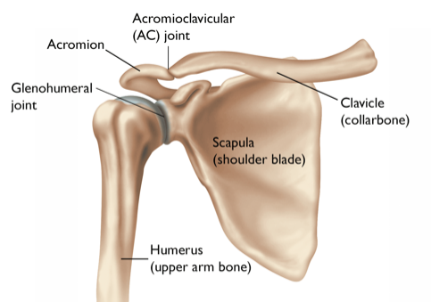
ANATOMY LESSION: THE SHOULDER – big ball on a flat socket, 360º movement, stability dependent on the muscles and tendons
Notes:
The shoulder is a very unique joint in the shoulder: There is a very big ball on the end of your arm bone (humerus) that moves on a very flat socket that comes off your shoulder blade. This is the only joint in the body that has 360 degrees of motion but it gains motion at the sacrifice of stability because the only thing holding the bone in the socket are a bunch of ligaments and tendons. Like the hip the shoulder also has a lip of cartilage (the labrum) that encircles the socket and helps to keep the ball in the socket with shoulder movement.

Slide 12
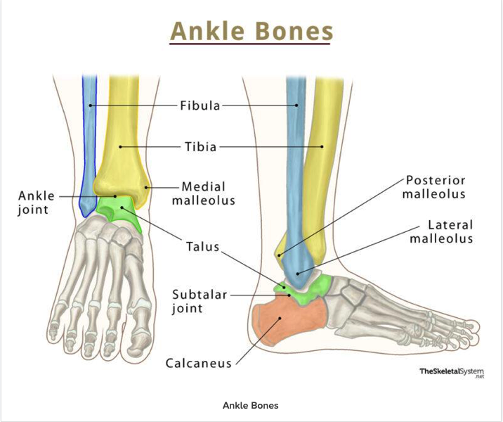
ANATOMY LESSION: THE ‘ANKLE’ – is a hinge joint at the end of the leg that moves the foot up and down
Notes:
The ankle is another unique joint because what we consider “ankle” movement is accomplished by two separate joints that work together to allow our foot to move in all directions to maintain contact with the ground and provide the propulsive force for gait.
The true ankle joint is the joint between the end of the tibia and fibula in the leg with the talus, which is the ‘top’ bone in the foot pictured here as the intersection between the yellow, blue and green bones. The ankle moves the foot up and down, or flexes and extends the foot.
The in-and-outward motion of the foot/ankle comes from the subtalar joint which is the intersection between the green and orange colored bones on the picture above.

Slide 13
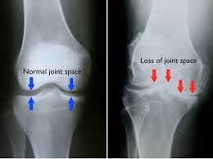
WHAT IS ARTHRITIS?
ARTHRO – meaning joint
ITIS – meaning inflammation
Arthritis is a wearing away of the cartilage that caps the ends of the bones, resulting in pain, stiffness, swelling reduced range of motion, warmth of the joint
Notes:
In medical jargon, ‘arthro’ means joint and ‘itis’ means inflammation. So arthritis is the inflammation of a joint that results in the damage to and wearing away of the cartilage that caps the ends of the bones. This causes pain stiffness, swelling, reduced ROM and warmth of the joint involved.
You can see a normal knee in this picture on the left with the blue arrows; the black line between the arrows is not empty space, rather that is where the cartilage that caps the ends of the bones is. There is no calcium in cartilage so you don’t ‘see’ it directly on an xray. Rather when we are looking at an xray of an arthritic joint, what we see is the consequences of the loss of the cartilage, like the picture on the right with the red arrows where there is no joint space any longer because the cartilage has been worn away in the knee and the bones are rubbing on each other.

Slide 14
A WORD ABOUT CARTILAGE:
There are two types of cartilage in the knee:
ARTICULAR cartilage – this caps the ends of the bones and is what wears away with arthritis
MENISCAL cartilage – this is different type of cartilage that acts like a ‘spacer’ between the ends of the bones in the knee
95% of people with knee arthritis also have tears in the meniscus. This is an expected finding! Surgery for the meniscal tear won’t improve the knee function or pain.
Notes:
When we are talking about arthritis, we are talking about the ARTICULAR cartilage, or the cartilage that caps the ends of the bones.
In the knee there is a special cartilage called the meniscus. This is a C-shaped piece of cartilage that sits between the bone ends. If you have arthritis, you will have a tear in the meniscus. If we go back to the previous slide of the arthritic knee with bone rubbing on bone…. (go back to the previous slide to demonstrate this) you can understand that the meniscus between the bone end WILL get ground up by the bone rubbing on bone process of arthritis.
We know that 95% of people with OA have meniscal tears. IT IS EXPECTED. So an MRI to demonstrate a meniscal tear won’t change the treatment you need, and cutting out the meniscal tear won’t improve your pain or knee function because all you do is remove the spacer from between the bone ends and you don’t change the fact that there is still no cartilage in the knee with bone rubbing on bone. Surgery for meniscal tears in the presence of arthritis in the knee won’t help.
The labrum in the hip and shoulder is sort of like the meniscus in the knee, and we expect to see tears in the labrum of the hip and shoulder in persons over 50 and those with arthritis in the joint.

Slide 15

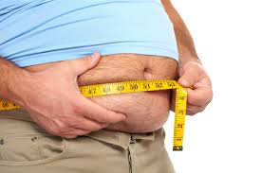
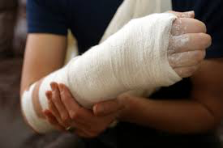
WHAT CAUSES ARTHRITIS?
Genetics
Obesity
Previous injury
Notes:
So: everyone wants to know why they have arthritis: Well, this is something I jokingly say you can blame your parents for because there is a strong GENETIC influence to develop arthritis.
But OBESITY is also a big factor in arthritis, and it is more than just the added weight being carried on joints that contributes to arthritis. Rather there are chemicals produced in fat tissue called adipokines and leptin. These are chemicals that induce inflammation and they have been implicated in degenerative and inflammatory processes in joints. Obese individuals have higher concentration of leptin and research identified that leptin influenced the metabolism of cells in the cartilage and creates an inflammatory environment, which leads to the progressive cartilage injury and loss in the joint.
And PREVIOUS TRAUMA to the joint surface is another big factor to cause arthritis. We have a generation of people that grew up being active and they had injuries, that as a kid, we didn’t think much of because kids heal easily and quickly, but those injuries then become arthritis with time.

Slide 16
MANY FACTORS CONTRIBUTE TO ARTHRITIS
Obesity
Microfractures
Bone remodeling
Loss of joint stability
Anatomic abnormalities
Trauma
Neuromuscular dysfunction
Aging
Genetic and metabolic diseases
Inflammation
Immune system activity
Abnormal Stress
Abnormal Cartilage
Compromised cartilage
Biophysical changes
Collagen network fracture
Proteoglycan unraveling
Biochemical changes
Inhibitors reduced
Proteolytic enzymes increased
Cartilage breakdown
Notes:
This is a busy slide, but it is meant to show you that as much as we may still refer to arthritis from “wear and tear” it is a much more complicated disease than just that. There are a number of factors that create abnormal cartilage and abnormal stresses on joints that together compromise the cartilage. then with time and ongoing physical and chemical changes to the joint, the cartilage breaks down and the arthritis progresses.

Slide 17
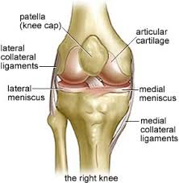
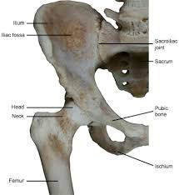
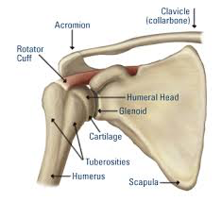
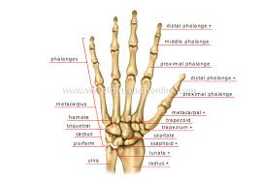
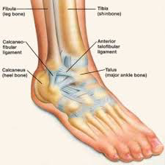
ARTHRITIS CAN AFFECT ANY JOINT
Notes:
Although most of you on this call this morning have knee, hip or shoulder arthritis, it can affect ANY joint in the body; and it is quite common in the fingers and the base of the thumb in the hand.

Slide 18
WHY DOES ARTHRITIS CAUSE PAIN?
There are no nerve endings in cartilage… bone has lots of nerve endings
The loss of cartilage results in exposed bone... Bone rubbing on bone is painful
The capsule/lining of the joint gets inflamed which causes pain
The capsule secretes more fluid into the joint which increases the pressure/pain in the joint as the fluid ‘splints’ the joint making it stiff and painful
Notes:
This slide: explain that arthritic joint pain is from several sources: from bone, nerves, capsule, synovial fluid

Slide 19
TYPES OF ARTHRITIS
There are two broad categories of arthritis:
OSTEOARTHRITIS (OA)
INFLAMMATORY ARTHRITIS
    a.k.a inherited arthritis, autoimmune arthritis
    Rheumatoid Arthritis (RA)
    Gouty arthritis
    Psoriatic arthritis
    Arthritis associated with Crohn’s disease
    Ankylosing Spondylitis
Notes:
Today we are talking about OSTEOARTHRITIS,
There are other forms of arthritis that are rheumatologic in nature, that are autoimmune like RA, PA, arthritis associate with CD… but it is possible to have OA along with these other rheumatologic diseases.

Slide 20
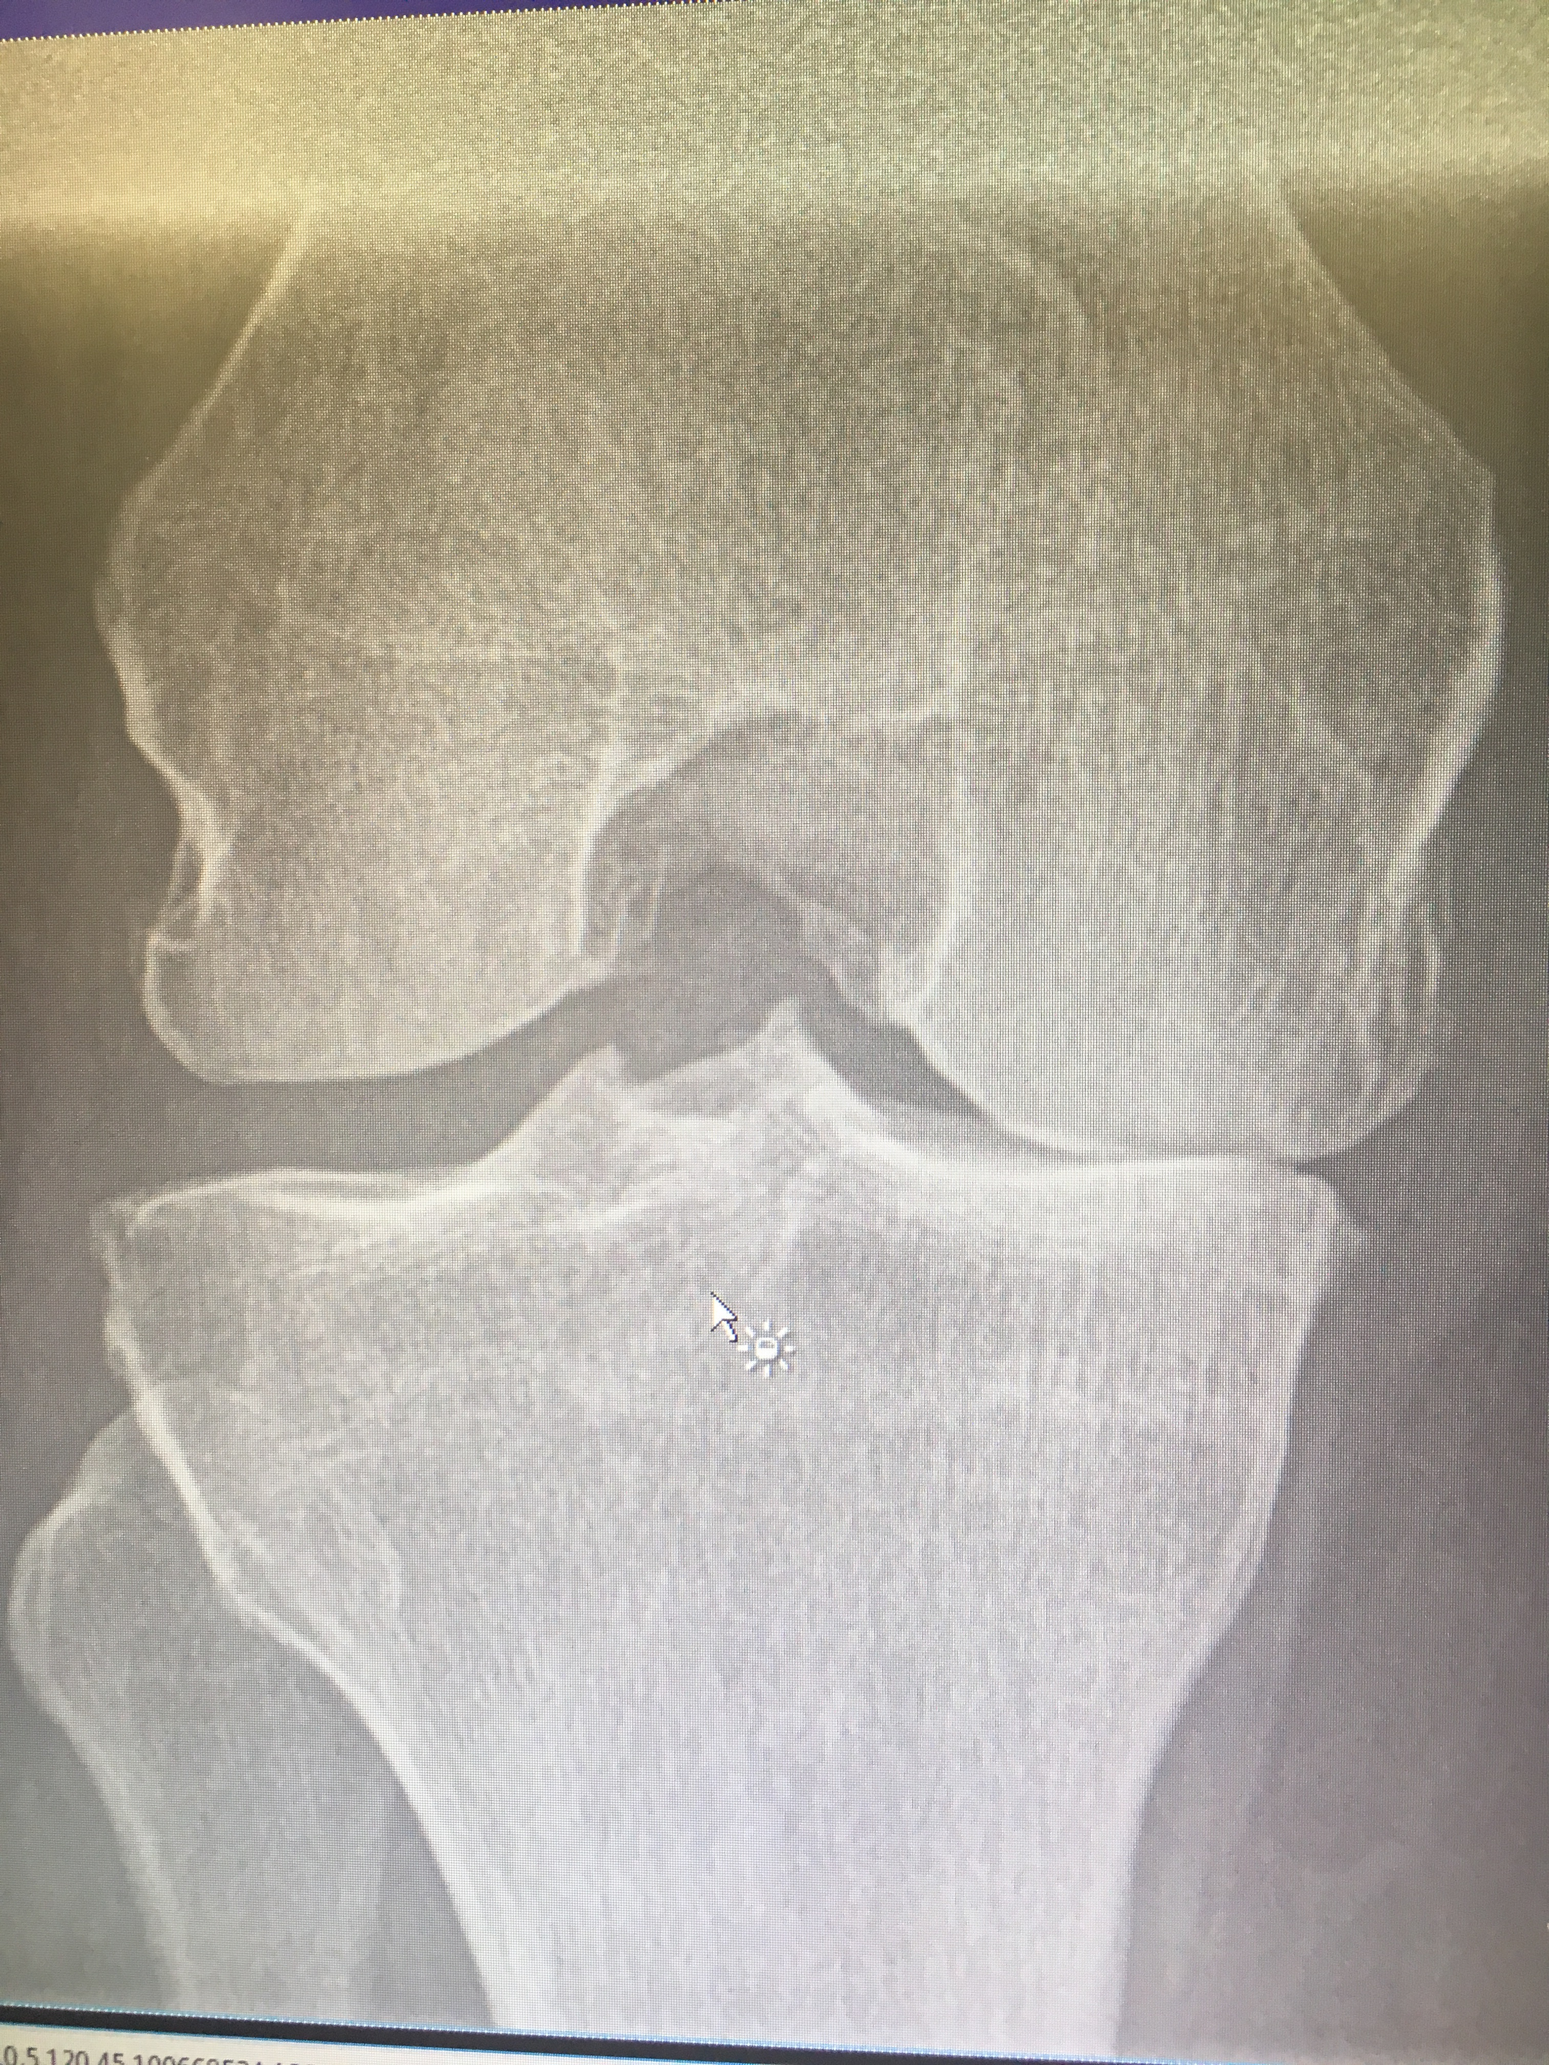
ARTHRITIS IS EASY TO DIAGNOSE:
History of the joint problem
    Usually non-traumatic onset of increasing pain, swelling , stiffness of the joint
    Sometimes history of prior injury to the joint
Physical exam
      Heat, swelling, loss of range of motion, angular deformity, grinding sensations
  Weight-bearing X-ray…
  NOT MRI or US
Notes:
Arthritis is easy to diagnose, and you don’t need an xray to make the diagnosis.
In someone over the age of 38, who has the non-traumatic onset of pain, swelling, stiffness that lasts less than 30 min in the morning, this is arthritis until proven otherwise.
On physical exam you will find that the joint is enlarged, the knee may be more bow-legged or knock-kneed. The joint may be warm to the touch, and swollen, there is often a crunching or grinding sensation in the joint.
An xray will support the clinical diagnosis and what we are looking for is narrowing of the joint space, sometimes we see new spurs of bone that form off the edge of the joint (called osteophytes). The bone underlying the joint surface can develop cysts in the bone from the extra joint fluid getting pushed into the bone, and the bone underlying the thinning cartilage often gets really dense and hard and looks ‘whiter’ on the xray (sclerosis).
AnMRI is not required to diagnose arthritis, as everything you need to know is demonstrated on the Xray – and we presume that the meniscus is torn because 95% of arthritic knees have meniscal tears. There is no value in an US to assess the arthritic knee structures, as the US cannot image what you want to see in arthritis.

Slide 21
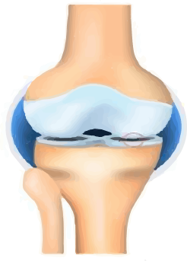
KELLGREN-LAWRENCE GRADING SYSTEM
OA diagnosed based on symptoms and clinical findings
Imaging: joint space narrowing, subchondral sclerosis, osteophytes, cysts
Severity of OA is only weakly correlated with knee pain or x-ray findings
Grade I
Doubtful
Grade II
Mild
Grade III
Moderate
Grade IV
Severe
Minimum disruption
Already 10% cartilage loss
Joint space narrowing
Cartilage is beginning to break down
Osteophytes present
Moderate joint space reduction
Cartilage loss down to
bone
Joint space greatly reduced
60% of cartilage lost
Large osteophytes
Notes:
This slide is a little confusing, but we have added it here for those of you who like to read up on the things that ail you, because if you are reading about arthritis, you may find reference to a Kellgren-Lawrence - or KL – grade of arthritis. This is something that is only used in research as a means of trying to standardize what is a very subjective way to grade arthritis. But this is NOT relevant when it comes to clinical treatment or management of arthritis because the severity of the arthritis process is only very weakly correlated to pain or the xray findings. That means that you can see horrible looking xrays and the person may not have much pain, or you can see xrays with very little arthritic changes and the person complains bitterly of pain. Therefore we diagnose – and treat – arthritis based on the clinical findings, pain and function.
Using the Kellgren-Lawrence radiographic grading system:
Grade 1 OA involves doubtful joint space narrowing (JSN) and minimal cartilage loss.
In Grade II, some JSN is occurring, and osteophytes are present.
Grade III OA involves moderate JSN and possible bond-end deformity.
By Grade IV, large osteophytes are present, JSN is marked, and there is severe loss of cartilage

Slide 22
WHAT YOU NEED TO KNOW ABOUT ARTHRITIS
Pain does not always correlate to the x-ray findings
Joints will get stiffer/lose range of motion as the arthritis progresses
It is not going away
It will get worse with time
You should be in the driver’s seat of your arthritis care and management
PROPER EXPECTATIONS: pain management not total pain relief
              decrease functional limitations
              increase quality of life

Slide 23

EVIDENCE-BASED TREATMENT OF ARTHRITIS
NONSURGICAL
1. *Non-drug related treatment
2. *Medication-related treatment
2.1. *Injection-related treatment
3. Unproven treatments
3.1. Ineffective, potentially harmful treatments
SURGICAL
Notes:
We are going to pause here before we move on to discuss treatment to see if there are any questions about arthritis, and what it is.
Okay, then we are going to move on to what everyone really wants to learn, which is how to treat arthritis. We are going to focus on the treatments that medical literature outlines that there is evidence that the treatment works. We are not going to discuss unproven things that don’t have any scientific basis to using them.
We always start with the non-drug related treatments and maximize that before adding in any medications and/or injections.

Slide 24
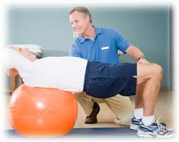
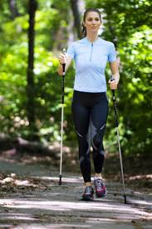
NON-DRUG RELATED TREATMENT OPTIONS
Exercise
Physical therapy
Activity modification
Braces
Weight loss/management
Cane/walking poles
Notes:
This is a list of the non-drug related treatments that are recommended for arthritis, and you can see that the number one thing is exercise: many patients do better just with appropriate exercises, avoiding prolonged or excessive impact loading and strengthening supporting muscles

Slide 25
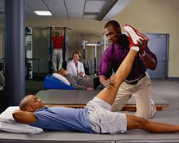
EXERCISE & PHYSICAL THERAPY
MOST important part of treatment!
Goal to develop and maintain strength, flexibility and ROM
DAILY home program to address aerobic conditioning, strength and flexibility
Follow up with your PT 3-4x/yr
Online resource: MacEwan University Health Center → Sport and Exercise Medicine, scroll down to bottom page
Notes:
Exercise is the most important part of treating arthritis. Exercise is a powerful tool in the treatment of OA. While exercise cannot cure OA, it is important in maximizing function and improving quality of life. A carefully planned exercise program can help to slow or reverse the body’s response to joint pathology by increasing flexibility, strength and endurance; address impairments, functional limitations and disabilities resulting from arthritis; and improve overall health.
This needs to be a DAILY home exercise program, ideally that is prescribed by a physical therapist to address your specific weaknesses. And as your arthritis progresses, and as you continue with a daily exercise program, your needs will change, so touching base with a good PT who understands arthritis and can tweek your program 3-4 times a year is ideal.
For those who may not have access to a physical therapist to get a program tailored to your needs, we do have a basic, 4 stage arthritis exercise program on the MacEwan University website that you can work through at your own pace. It is available on the website, and the QR code on this slide will link you to that site.

Slide 26
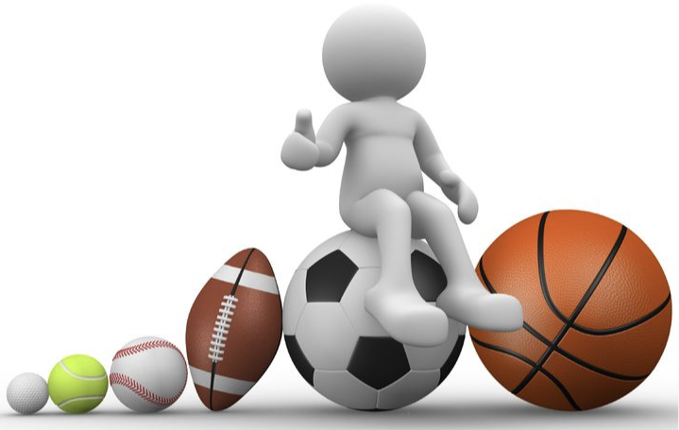
EXERCISE & PHYSICAL THERAPY
GLA:D Canada
A well researched, very successful group exercise program for arthritic hips and knees
    Neuromuscular retraining, not the same thing as sport activities
    Example: in/out of chair…
    many locations across Alberta- in person or virtual options
        Cost associated with different programs differs
        GladCanada.ca has a listing of all the clinics offering this program
Notes:
Physical therapy and exercise in managing arthritis is so important that a group of researchers in Denmark have created GLA:D – which is the GOOD LIVING WITH ARTHRITIS IN DENMARK program. We brought it to Canada about 10 years ago. This is a very well researched very successful exercise program for people with hip and knee arthritis. The GLA:D program is a couple of education sessions followed by 12 sessions of group-based neuromuscular exercises that improve strength, flexibility and range of motion.
(describe or demonstrate the example of getting in/out of a chair with having to use hands to push up and flop into the chair vs ability to get in/out without hands and how strength in the muscle groups to do that is a huge factor in having strength to do ADL’s, like getting in/out of car, up/down stairs, in/out of bed, etc..)
GLA:D is usually provided through a physical therapy clinic and the costs may vary by clinic, but if you have private health insurance the GLAD:D costs can be covered to the limit of your plan.
There are many clinics in Alberta offering GLA:D and some clinics offer in-person as well as virtual programs. You can find a GLA:D program near you on the GLAD Canada website.

Slide 27
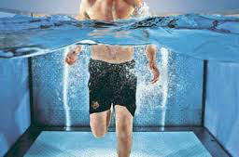
ACTIVITY MODIFICATION
Joints need activity to stay healthy
Non-impact activity is best
Use pain as guide
    Causing or increasing pain
  Hurt vs. Harm principle
Notes:
Joints need activity to stay healthy. Joints need to move. But the key with arthritic joints is to modify activity to more non- or low-impact activities. For example, water aerobics instead of land-based aerobics; swimming, biking, cross country skiing instead of running and basketball. The elliptical trainer instead of running, etc…
I suggest you make a list of the things you do: the A column is all the things that hurt or increase pain. The C column are the things that don’t hurt, and the B column are those that are in between. If you stick to the things in the C column and maybe the B column activities, you will stay active and healthy with less pain.
But with activity, HURT does not mean HARM. So, if you choose to do something in the A column, it is going to hurt, you may suffer a bit with more stiffness, pain and swelling, but you are not making things ’worse’, it doesn’t make the arthritis progress any faster, it just means living with pain. But if the pleasure you get from the activity is greater than the pain it provokes, then carry on. But a key principle in managing OA pain is to modify your activity using pain as a guide: if something is causing or increasing pain, then back off.

Slide 28
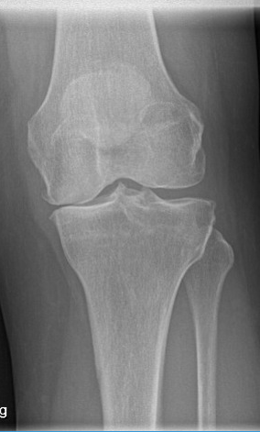
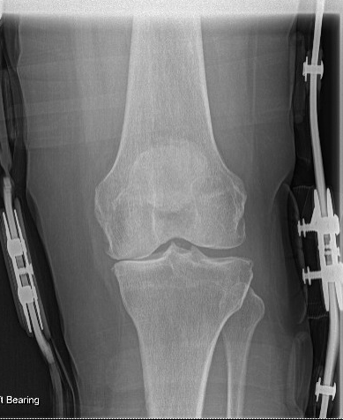
BRACING
KNEE UNLOADER BRACE
For those who have one side of the knee joint wearing more than the other
Wear for all activity of daily living, not just for activity
Custom made
Expensive → Alberta Aids to Daily Living program
Notes:
Bracing can be a very effective option for helping to manage arthritis pain. For those who have arthritis in only half of the knee – i.e the inside or outside half of the knee, then a brace called an UNLOADER may be a good option for you. You can see in this picture on the left, there is no cartilage left on the inside half of the knee. The red lines show you the forces through this knee and you can see from the angle of the lines how the forces are loading the inside part of the knee where there is no cartilage left. On the xray on the right in the brace, you can see that the yellow lines are more in line, which moves the forces in the knee more to the outside of the joint where there still is good cartilage. So for those with what we call unicompartmental arthritis (meaning arthritis only on one half of the knee) this may be a great option to help manage OA pain. These are expensive braces ($1500) but if you have private health insurance, it will cover a portion of this cost and the Alberta Aids to Daily Living will cover the remaining cost – up to the full cost if you don’t have private health insurance.

Slide 29
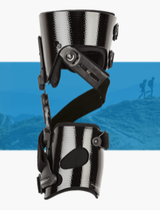
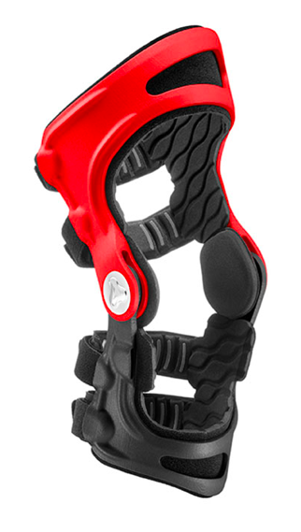
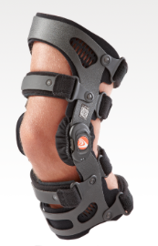
UNLOADER BRACE OPTIONS FOR KNEE
BREG OSSUR OSSKIN
Notes:
These are pictures of the three most common Unloader braces.
It is my opinion that if you are considering an Unloader brace that you purchase it from an orthotist that has the ability to make/provide more than one option of brace, because everyone has a different shaped leg/knee and – although these are custom made braces – this is not a ‘one size fits all’ type of brace and one style of brace may fit your leg better than the other, so having the option of choice of brace is important. These braces are best worn on the skin, not over clothing. They are a little bulky but do fit under a pair of jeans.

Slide 30
EVEN A SIMPLE KNEE SLEEVE HELPS…
Provides some support, warmth
Compression helps with swelling
Stimulates the nerve endings in the skin and helps the brain know where the knee is in space which helps with muscle recruitment and feeling of stability and trust in the knee
Notes:
But even a simple knee sleeve helps, even if you have arthritis in multiple compartments of the knee. And there are sleeves for most joints.
A sleeve will provide some compression so it helps with swelling in the joint. It keeps the joint warm which helps with decreasing the sense of stiffness in the joint, and most importantly, it stimulates the nerve endings in the skin which helps your brain know where the joint is in space so it helps with muscle recruitment and a sense of trust and stability with the joint.

Slide 31
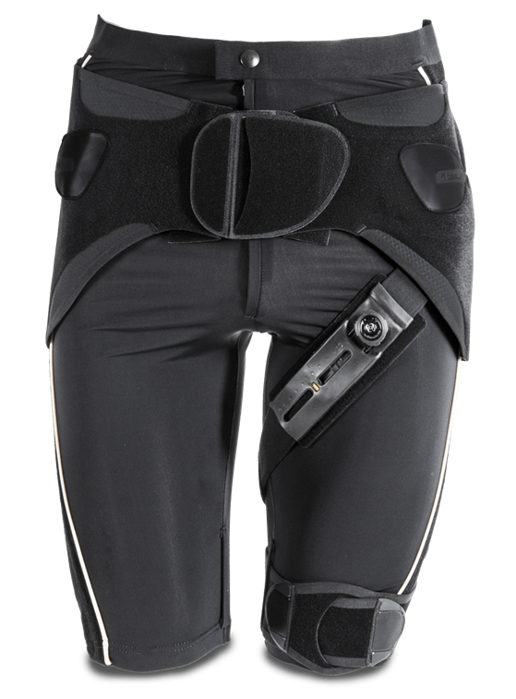
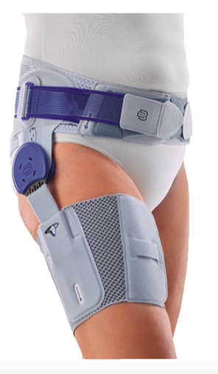
UNLOADER BRACE FOR HIP
can be for fitted for one side or bilateral arthritic hips
Notes:
There are also now unloader braces for the hip. These however are NOT covered by the Alberta Aids to Daily Living, and they are expensive ($1500) but the company has a policy that if you try the brace for a month and you don’t get any benefit, they give you your money back. The Unloader brace or the hip tends to work best if you have patches of cartilage wear in the joint, they are not so great if the cartilage is wearing off the whole joint. But you can see they are a bit bulky and they are worn under clothing.

Slide 32
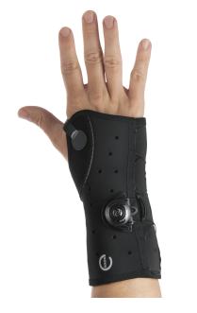
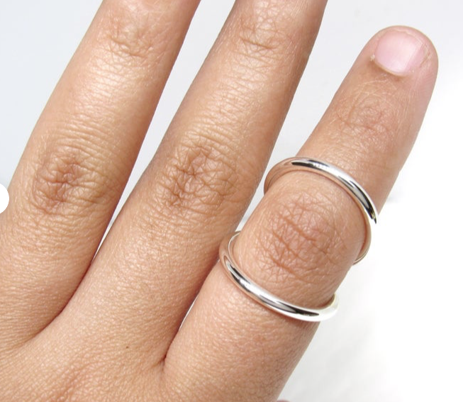
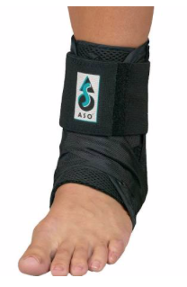
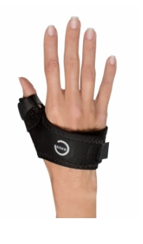
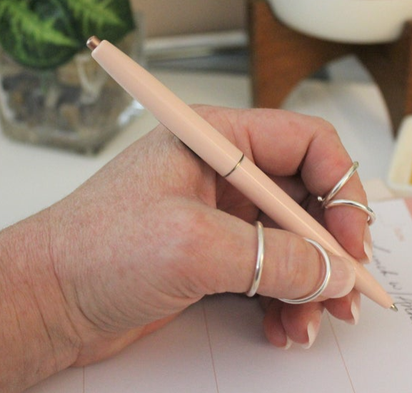
ANKLE, FINGER AND WRIST BRACES…
Notes:
There are braces for almost every joint, and some of them can be quite attractive like these sliver ring braces for arthritic fingers.

Slide 33
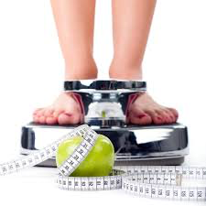
WEIGHT LOSS / MAINTENANCE
1/3 adults and children in Canada are clinically obese
Average Canadian takes less than 5000 steps a day (sedentary)
      Goal should be 10 000+ steps a day
  Weight is magnified 3-5x as it goes through the lower limb joints with ambulation
    If you are 10lbs overweight, that is 50 extra pounds being carried on worn-out, painful joints with each step
Notes:
Weight loss or maintaining a healthy weight is important in the management of arthritic joints. Weight is magnified 3-5 times as it goes through the lower limbs, so if you are 10 lbs overweight, that can be 50 lbs through an arthritic joint with every step you take. Even a small amount of weight loss can make a big difference to your comfort level with arthritic joints.
Furthermore, with increasing obesity, there are increased amounts of chemicals produced in the fatty tissue called adipokines and leptin. These are key elements in creating inflammation in the joint and are a factor in the biochemical process of arthritis. Reducing weight reduces these pro-inflammatory mediators and may impact the process of arthritis.

Slide 34
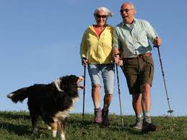
MOBILITY AIDS: CANE OR WALKING POLES
Can transfer 25% of body weight to the shoulders and off-load the joints
Keep a more upright and fluid gait, decreases the altered forces of limping gait
Some will feel more stable, more confident with a walker. Any manner of mobility aid is helpful.
Notes:
Mobility aids are another non-drug related approach to treating arthritis. There is an inappropriate sigma around the use of a cane or walker that it makes one look ‘old’. On the contrary, being bent over, limping and moving badly is more ‘aging’ than being to walk tall, with good balance and cadence.
A cane or walking stick can transfer 25% of your body weight to the shoulders, so as long as you don’t have arthritis in the shoulders, it will help to keep you more upright, give you a more fluid gait and decreases the altered forces of a limping gait.
If you don’t like the look of a cane, Nordic walking poles can do the same thing, and you may feel more supported using poles because you can have one in both hands. If you watch people walking in the river valley, you will see many people – young and old – using walking poles. It has become the sexy thing now; it also increases the movement of the upper extremities which helps with improving overall fitness and calorie expenditure so it can help augment weight management/loss by moving more of the body.
If you are really unsteady on your feet, using a walker may be a better choice to help you balance and weight bear through the walker.

Slide 35

MEDICATION-RELATED TREATMENT OPTIONS
Medications
    NSAIDs
    COX-II
    Cymbalta
    *Tylenol – max 1 gm 4x/day
    (OARSI guidelines vs. your doctor’s
    recommendations)
Notes:
We are going to pause here, before we talk about medications for arthritis to see if anyone has any questions about the non-drug related treatments for arthritis….
So, moving on… if you have maximized the non-drug related management options and you still have pain, you might want to consider medications for pain. Medications give you flexibility to treat when you think you need relief. You need to discuss medications with your doctor because you may have other medical conditions that make certain medications contraindicated.
NSAIDs are a group of medications called Non-Steroidal Anti-Inflammatory Drugs. These are very effective at managing pain and the swelling that occurs with arthritis, but they also have potential side effects that can cause stomach upset and bleeding in the stomach, they can affect your kidney and blood pressure. When you use NSAID’s in the management of arthritis, you need to take them with a second medication that protects your stomach from the effects of the anti-inflammatory, and you should not take them every day of the week. I usually recommend that you can take the NSAID’s four days out of seven in the week, and you choose what days you need them. This gives you the flexibility of augmenting your arthritis management depending on your needs; for example, if you are going to go for a hike and you know you will be sore after, then you can take an NSAID after your hike to settle the symptoms. Of if your knee is swollen and stiff and you have a golf game planned, then you can take an NSAID before your game to make the knee more comfortable so you enjoy the game more.
The COX-IIs are a new form of the old anti-inflammatories that are supposed to help with pain and inflammation but not have as much risk for side effects. They are used in the same manner as the NSAID’s.
Cymbalta is an antidepressant medication, but it also has the capacity to alter the brain’s perception of pain which can help with arthritis pain. For example, we use Cymbalta with people who have phantom pain after they have had an amputation. For some, even when the leg is removed, the hard-wiring of the brain still perceives pain: we call this phantom pain. Cymbalta stops phantom pain. It can also change the brain’s perception of pain from arthritic joints, and is an option for daily medication use that you can consider in the management of your arthritic pain.
Tylenol is a good drug, but many people don’t use it correctly. The most recent version of the international guidelines for OA treatment had taken Tylenol off the list of recommended medications – not because it doesn’t work, but because people who are in pain take a lot of medications to stop pain and Tylenol (or acetaminophen) is a medication that can cause liver damage if you take too much. A safe dose for an adult is 1 gram – that is 2 extra strength Tylenols – four times a day. You may not need it that frequently but that is the MOST you should be taking in a day.

Slide 36
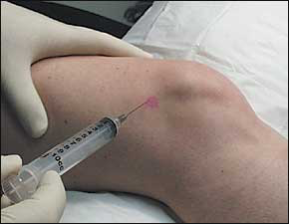
MEDICATION-RELATED TREATMENT OPTIONS
2. Injections
a. Hyaluronic Acid (HA)
b. Steroid (cortisone)
c. Platelet Rich Plasma (PRP)
d. Autologous Concentrated Protein (ACP) preparations
(e. stem cell)
Notes:
Medications give you flexibility in managing arthritis, but the injections are probably the mainstay of managing arthritis. There are three things that we commonly use for arthritis and they have very different purposes and effects.

Slide 37
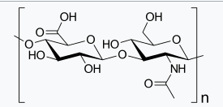
HYALURONIC ACID
a.k.a. HA, viscosupplementation
Provides benefit for 6-12 months*
Can take 3-6 weeks before notice effect
Most effective if product is high molecular weight and highly cross-linked
Notes:
Hyaluronic acid – or HA for short – has been the mainstay of OA treatment for about 30+ years. The joint capsule normally makes HA, but in an arthritic joint, the amount and quality of HA is diminished. When we inject HA into the joint, it helps the joint to make more and better HA, it improves the viscosity of the joint fluid, and helps with pain relief. This is kind of like a lube-job for the joint. The challenge of using HA is that there is no way to predict how well or for how long it is going to work – this is something you have to try and then monitor the effect. In generally, we expect 6-12 months relief with the HA products. They work better for the earlier staged OA than with advanced disease but even with advanced disease they can provide some benefit. And the sooner you start the HA treatment and the longer you use it, the better the effect. However, this is not a treatment that works quickly, and it may be 3-6 weeks before you notice effect or benefit. We do know from medical research that to be the most effective and to stay in the joint longer, the HA product should be high molecular weight and highly cross linked. There are currently 3 common HA products on the market:
Synvisc: high MW, highly cross linked, been around the longest/30 yrs on market, made from avian source (rooster combs) so if you are a committed vegan this is not a good option. It also is an injection of 2-6 ml (depending on the size and volume) of the joint so has more range in cost (i.e. 1, 2 or 3 syringes)
Durolane: different molecule, is a gell made from non-avian sources, is high molecular weight and highly cross linked, shown in human research studies to stay in the joint the longest of all the HA products, 3 ml syringe
Orthovisc: moderate MW and cross linked, cheaper product, 3 ml syringe
Cingal: orthovisc + steroid, good for a quick onset of effect from the steroid with the more prolonged effect from the medium molecular weight/cross linked HA

Slide 38
STEROID (cortisone injection)
To settle a ‘flare’ of arthritis, settle swelling
Works quick (2-5 days)
Won’t create lasting pain relief
3-4x per year when waiting for joint replacement
Notes:
Steroid is another option for a medication we can inject in joints but it is also a medication that has a bit of a bad rap, and is also over-used. Steroid is an anti-inflammatory medication. So if there is inflammation in the joint then a steroid injection to settle inflammation is helpful. Steroid works quickly (2-5 days), but it doesn’t last long (2-3 months usually). But frequent and regular use of steroid has been considered to negatively impact the health of the cartilage that is left in the knee.
While the limited evidence suggesting that steroids are not safe is not convincing, there is good evidence that inflammation in joints is bad. So we use steroids judiciously to settle a flare of arthritis. For example, if your OA management has been going well, and you go for a hike and flare up the knee, then a steroid shot to put out the fire is appropriate. But we don’t use steroids on a regular –i.e every 3-4 month basis – until all other options have been exhausted and you are waiting for a joint replacement, because the more you use steroids, the less effective they can become.
NOTE TO PRESENTER: TWO STUDIES LISTED BELOW MAY HELP IN ADDRESSING QUESITONS FROM THE ATTENDEES REGAREDING THE SAFETY AND EFFICACY OF STEROID
In 2003: Raynauld did a randomized, double-blind trial of 68 patients with knee OA compared the efficacy of IA injections of triamcinolone acetonide 40 mg (34 patients) or saline (34 patients) every three months for up to two years. The primary outcome variable was radiologic progression of joint space narrowing of the injected knee after 2 years.
Not only did knee pain and stiffness significantly improve with the corticosteroid vs. saline injection (p < 0.05), but no deleterious effects of long-term administration were noted, supporting the long-term safety and efficacy of IA steroid injections for patients with symptomatic knee OA.
2017: Contrary to the RCT by Raynauld et al, a RCT by McAlindon et al found greater cartilage volume loss and no significant difference in knee pain between intra-articular triamcinolone vs. saline for 140 patients with symptomatic knee OA.
However, it should be noted that in these studies the corticosteroid was given every 12 weeks for two years, which is generally more aggressive than use for knee OA in typical practices.

Slide 39
PLATELET RICH PLASMA (PRP)
Benefit similar to HA in early OA
More expensive than HA
It may alter the biochemistry of arthritis as well as provide pain relief
Uncertain value in more advanced OA
nSTRIDE and other ACP formulations
Stem cell therapy
        Research based, not practically effective
        in AB, only in a minor OR/procedure room
Notes:
Platelet-Rich Plasma (or PRP) is one of the new-kids on the block for OA management. Platelets are cells that clot your blood, but they also have about 300 active growth factors in them that are important for tissue healing. While we don’t know exactly how PRP works in arthritic knees, there is good evidence that PRP injections into arthritic joints helps pain relief. It works better in earlier stages of arthritis than later stages, and the medical studies show that it is about the same effectiveness as HA products, but it is also more expensive than HA. But, what some people like is that this is your own blood, it is not a foreign substance that you are injecting. Unfortunately, this is like the HA products in that you have to try it to determine if it will provide benefit for you.
One of the newest tools in the toolbox for managing OA is a product called nStride, which is an ACP therapy. This stands for Autologous (meaning from your own body) Concentrated Proteins. This is a Health Canada approved treatment and is what all the NBA and pro athletes are heading to Europe to get injected in their joints to help prevent or treat arthritis. This is essentially a super-dooper form of PRP, because over the years of using PRP in arthritis, what is starting to emerge is that there may be 10-15 specific growth factors in the platelets that are actually doing something to alter the biochemistry of the arthritis process. So, when we use ACP formulations (or PRP) there MAY BE an impact on the underlying arthritis process as well as pain relief, but we just don’t have that information yet, and it likely will be a long while yet before we can definitively confirm or refute that consideration.
Stem cell therapy is on this slide NOT because it is an effective or recommended treatment, but rather as a caution to you to NOT waste your money on this form of treatment. Stem cells are cells in the body that can change into any other type of tissue. There is a lot of medical research using stem cells because they potentially could be the cure for many diseases. However, medical research is NOT at the stage where we can consistently and reliably make stem cells turn into cartilage. Furthermore, if we are able to make stem cells grow into cartilage, when we transplant the cartilage into the joint, it dies off when you start to weight bear through the joint. So, although this is a therapy that has promise, it simply is NOT at the state yet that is practical or reliable. In fact, in Alberta you cannot receive stem cell therapy unless you are part of a research study and the procedure has to be done in a minor procedure or operating room.

Slide 40
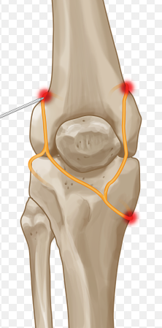
Radiofrequency Ablation of the Geniculate Nerve
The geniculate nerve provides sensation to the knee
Can ‘freeze’ the nerve, with good pain relief may benefit from a simple procedure that ‘burns’ the nerve
May provide 6-12 months pain relief
Does not change the underlying OA process
Is now covered under medical benefits
Starting to do it at the hip too
Notes:
Radio-Frequency ablation of the Geniculate Nerve is a minor procedure that can have a major impact on pain from arthritic knees. The geniculate nerve gives sensation to the knee. What we do in this procedure is put a needle through the skin down to the nerve and freeze it up, then we feed a wire probe through the needle and using the probe, we burn – or ablate – the nerve. By removing the nerves ability to transmit sensation, you get pain relief to the knee. It does nothing to change or alter the arthritis, and the arthritis will still progress in the knee, but with the RF you just don’t feel the pain. The nerves will eventually grow back, but this procedure can be repeated.
This can be done for hip OA as well, but the innervation of the hip is a little more complicated than the knee and the outcomes are not as predictable as they are at the knee.

Slide 41
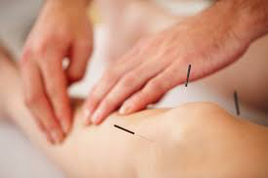
ALTERNATIVE MEDICINE and UNPROVEN THERAPIES
Only if treatment is affordable and doesn’t create financial burden as not scientifically proven to be beneficial, but some do gain relief:
Acupuncture
Massage
Glucosamine & Chondroitin Sulfate
Notes:
Our goal in this session is to stress to you the evidence-based, effective treatment options for managing arthritic pain. There are an endless number of things that you will hear about or may have tried that have no evidence of any effectiveness, and no benefit. Any alternative or unproven therapies should only be considered if the treatment is affordable and won’t break the bank, and if you feel you get benefit.
Acupuncture is a great pain-relieving modality, but it doesn’t create lasting benefit. So, it is not practical or effective to be spending a lot of money every few days for acupuncture, but if you have someone in your life who does acupuncture and they are willing to do it for you for the cost of a box of needles, and you get pain relief, then this is a good thing.
Massage may help with feeling of pain relief , feeling less stiff and generally better well being but it doesn’t provide benefit to managing arthritis pain.
Glucosamine and chondroitin sulfate are the building blocks of cartilage, and some people who take this as a supplement do get pain relief. There are some low-quality medical studies that have suggested that it may decrease the rate of cartilage loss in the joint. It is made from shellfish so if you have an allergy to shellfish you should not take this, and it is converted to a sugar in the body so as long as you don’t have very brittle diabetes, it does not have any negative side effects. If you want to try this, DO NOT buy it at a health food store, it is just really expensive and no better than the stuff you can get at Costco, which is $15 a month. If you try the G&C for 2-3 months and you think it helps, then continue, but if you don’t notice any improvement to pain, then stop taking the supplement.

Slide 42
CANNABIS – medical marijuana, smoked or vaped pot, edibles, oil, etc…
July 2013: Canada approved the use of marijuana on the basis of a legal determination of the right to use, NOT based on medical knowledge of efficacy or safety of the substance
Marijuana and cannabis are the common names for a plant that contains over 100 psycho-active compounds, most importantly:
      Delta-9 tetrahydrocannabinol (THC)
      Cannabidiol (CBD)
  Health Canada: “there is no scientifically defined dose of cannabis for any medical condition.”
  Cannabis is NOT considered a safe or effective drug
Notes:
When we started this discussion, we said we were going to talk about the evidence-based treatments. There is no evidence that cannabis is a safe or effective drug for arthritis pain. We have had to add these slides to the presentation because of the number of people asking about this drug treatment, so we have included a few words here that break-down the evidence for you in a couple quick comments:
In 2013, the Government of Canada made marijuana legal on the basis of the right to use, but that change was NOT based on any medical knowledge of safety or efficacy of the substance. When we are talking about marijuana, there are over 100 psychoactive compounds in the product, but most of the attention is given to THC and CBD. THC is the compound that makes you high; CBD is the compound that is being investigated for possible medical purposes.
EVERY provincial medical college has studied the medical evidence pertinent to marijuana and every provincial college has determined that cannabis is not considered a safe or effective drug. What is important to understand is that marijuana is fat soluble and accumulates in the body resulting in prolonged exposure of the brain to the substance over time, even after discontinuation of use. So the impairing effects of cannabis are broader than the syndrome of acute intoxication.
Health Canada has outlined, “there is no scientifically defined dose of cannabis for any medical condition.”

Slide 43
CANNABIS con’t ….
The risks far outweigh any benefits
      In 2018, the first very well designed, large, 4-year prospective study of non-cancer pain treated with marijuana products was published:
        Number Needed to Treat= 24
        Number Needed to Harm = 6
      Findings identified that people who used cannabis had greater pain and lower self-efficacy in managing pain
EVERY provincial medical College in Canada has reviewed medical marijuana
    The consistency of literature identifies a lack of benefit for use of cannabinoids/marijuana
Notes:
The biggest challenge with marijuana products is that we have a LOT of very poor-quality studies that are done with/on patients that are not cannabis-naïve and the findings are terribly biased. The first very well-designed study published results in 2018. This looked at the use of marijuana for non-cancer pain in over 5000 patients. When the people with Multiple Sclerosis were removed from the study (there is some evidence for the use of CBD in MS), the findings outlined that people who used cannabis had greater pain and lower self-efficacy in managing pain. Furthermore, the Number Needed to Treat (NNT) was 24 – meaning that 24 people needed to take cannabis before 1-person derived benefit, but the Number Needed to Harm (NNH) was 6. This is a 4-fold greater risk of harm than benefit with marijuana products.
The consistency of the literature identifies a lack of benefit for use of cannabinoids/marijuana.

Slide 44
THE RIGHT TREATMENT AT THE RIGHT TIME
After this education session:
      take some time to consider what you have done to manage your arthritis,
      consider what more you can/want to do to help control your pain and improve your function,
      follow up with your family doctor to discuss and implement your choices for managing your OA
Notes:
Our goal with this session has been to thoroughly educate you on what you should be doing to manage arthritis; we hope that we have accomplished that. But this has been a lot of information to absorb, so now we recommend that you take some time to consider everything you have learned here (if you need to review the information the slides are available on the website), consider what you have done so far to manage your arthritis, consider what you want to do next to help control your pain and improve your function, and follow up with your family doctor to implement your choices for managing OA.
If you decide that you would like to use injection therapies for managing your OA, the physicians at the GSSMC are available to provide that for you. You can call 780-407-5167 (GSSMC) or 780-250-6842 (Grant Mac) to make an appointment; just tell the medical office assistant that you participated in this COMET lecture and you will be booked in to see one of the sport medicine physicians for your injection.

Slide 45

TREATMENT OPTION: ASM
You may call 780-460-9977 to make an appointment with one of our SATHER REID SPORT MEDICINE CLINIC physicians if you would like to pursue injections with them to manage your OA.

Slide 46
TREATMENT OPTION: MUHC
You may call 780-250-6842 to make an appointment with one of our MacEWAN HEALTH CENTER sport medicine physicians if you would like to pursue injections with them to manage your OA.

Slide 47
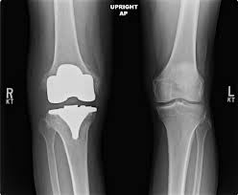
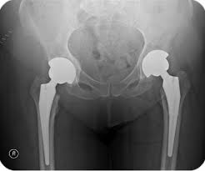
SURGICAL TREATMENT OPTIONS
JOINT REPLACEMENT : when pain interferes with work, sleep and play and all other treatments have been tried/exhausted and are no longer effective
Notes:
We will wrap up here with a brief word about surgical management of arthritis.
Just about any joint can be replaced: this is a picture of a total knee and total hip replacement. Joint replacement is done for pain relief, not to get you back to high impact activities.
In general, joint replacement surgery is a very successful surgery, but there are some (5-20% depending what study you read) that don’t get great outcomes and there are risks with surgery. So, the time to consider surgery is when you have pain that is interfering with work, sleep and play and you have exhausted all the non-surgical treatments and it is not controlling your pain.

Slide 48
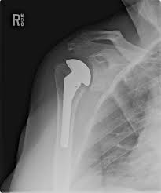
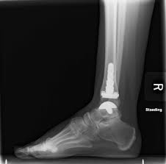
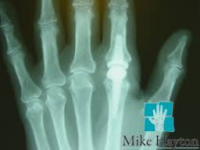
OTHER JOINTS CAN ALSO BE REPLACED
Notes:
This is a picture of a shoulder replacement, and ankle and finger joint replacement….

Slide 49
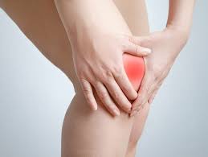

WHAT TO EXPECT FROM JOINT REPLACEMENT
Pain relief
Near normal range of motion
Return to low-impact activity
Better sleep
Discontinuation of medications
Notes:
After surgery, you can expect pain relief – but you might feel the joint ‘knocking around’ because it is a metal and plastic component that is implanted to the bone and some people feel the surfaces click together.
Joint replacement will usually restore a NEAR normal range of motion – but it is not a normal joint.
You can expect to return to low impact activities and gain better restorative sleep that is not disturbed by pain, and you will be able to discontinue the pain medications you need for the arthritic joint.

Slide 50
LIMITATIONS OF JOINT REPLACEMENT
Not a ‘normal’ joint
May dislocate if in precarious positions
Impact, contact, collision activity/exercise is NOT recommended
They do ‘wear out’ with time
Hardware presents risk for infection, stress riser for further injury
Notes:
But artificial joints are not ‘normal’: they can dislocate, they do wear out with time, and they may have to be replaced a second time – this is more of a risk when joints are put into younger people, i.e. less than 60. The metal component of the joint presents a stress riser on the bone so there is a risk for further injury to the bone above/below the implanted metal if you have an injury to the area. And the hardware in the bone increases the risk for infection, so you will need to be extra careful with protecting the integrity of your skin and gums, and you may need to protect the artificial joint by taking antibiotics if you are going to be having certain procedures done after the joint replacement.

Slide 51


